Slide 1
BLUESTOCK FINTECH
MUTUAL FUND ANALYTICS PLATFORM
FINAL PROJECT REPORT
Comprehensive Analysis of Indian Mutual Fund Performance, Risk Metrics,
NAV Trends, Sector Allocation & Investor Insights (2022 – 2026)
40
₹39M
15
5,000+
Funds Analyzed
Total AUM
EDA Charts
Investors
16.72%
0.54
15.91%
53.54
Avg CAGR
Avg Sharpe Ratio
Avg Alpha
Avg Fund Score
Tools: Python • Pandas • Power BI • SQLite • ReportLab • python-pptx • Git
Workspace: MutualFundAnalytics.code-workspace | OneDrive/Documents/Analytics Projects/BLUESTOCK FINTECH/MutualFundAnalytics
Bluestock Fintech | MutualFundAnalytics | June 2026

Slide 2
Problem Statement & Objectives
Why this project exists and what it set out to achieve
❓ The Problem
🎯 Project Objectives
P1
No Unified Comparison Tool
Build Automated ETL Pipeline
Investors lack a single platform to objectively compare 1,000+ mutual fund schemes across consistent, risk-adjusted metrics.
5-stage Python pipeline: Extract → Validate → Transform → Feature Eng. → Load. Full logging via run_pipeline.py.
Compute 6 Performance Metrics
P2
Raw CAGR Misleads
CAGR (1Y/3Y/5Y), Sharpe Ratio, Alpha, Beta, Max Drawdown, VaR/CVaR for all 40 funds.
Funds market 1Y CAGRs without disclosing Sharpe Ratio, Max Drawdown, or VaR — leading investors to chase performance.
Conduct 8-Dimensional EDA
15 original charts covering Industry, Performance, Risk, and Investor demographics.
P3
No Open Dashboard
AMFI's publicly available NAV data has no free, interactive visual analytics layer for retail investors.
Create 4-Page Power BI Dashboard
Interactive: Industry Overview, Fund Performance, Scorecard, Investor Analytics.
P4
SIP Abandonment Risk
27.2% of platform investors show AT_RISK payment gap patterns — no automated detection or intervention system exists.
Document & Deploy to GitHub
Clean codebase, docstrings, README.md, v1.0 tagged release at MutualFundAnalytics repo.
Bluestock Fintech | MutualFundAnalytics | Mutual Fund Analytics Capstone | June 2026
2 / 12

Slide 3
Data Sources & Project Output Files
All data is publicly available — fully reproducible | Workspace: MutualFundAnalytics/
INPUT DATA SOURCES
OUTPUT CSV FILES (MutualFundAnalytics/ root)
Source
Data Provided
Format
Frequency
File Name
Rows
Key Columns
AMFI India
NAV, AUM, Scheme Meta
CSV/Text
Daily
fund_scorecard.csv
40
fund_score, cagr, sharpe, alpha, beta, max_dd
mfapi.in
Historical NAV REST API
JSON
On-demand
cagr_comparison.csv
40
amfi_code, cagr_1yr, cagr_3yr, cagr_5yr
NSE India
NIFTY 50 / TRI Benchmarks
CSV
Daily
alpha_beta.csv
40
amfi_code, alpha, beta
BSE India
SENSEX / BSE TRI Index
CSV
Daily
var_cvar_report.csv
40
amfi_code, VaR_95, CVaR_95
SEBI Portal
Fund Category Classifications
Web/PDF
Quarterly
drawdown_periods.csv
40
peak_date, trough_date, max_drawdown
sip_continuity_report.csv
1,362
investor_id, gap_days, status
cohort_analysis.csv
2
cohort_year, avg_sip_amount, total_invested
tracking_error.csv
5
amfi_code, tracking_error
40 Funds
8 AMCs
500K+ NAV Points
2020–2026
Schemes Analyzed
Fund Houses
Data Volume
Date Range
Bluestock Fintech | MutualFundAnalytics | Mutual Fund Analytics Capstone | June 2026
3 / 12

Slide 4
ETL Pipeline Architecture
5-stage modular Python pipeline — run_pipeline.py orchestrates all stages with full logging
1 EXTRACT
2 VALIDATE
3 TRANSFORM
4 FEATURES
5 LOAD
→
→
→
→
extract.py
validate.py
transform.py
features.py
load.py
IN: AMFI URL mfapi.in API
IN: raw/nav_raw.csv
IN: raw/*.csv
IN: nav_clean.csv
IN: processed/ folder
OUT: raw/nav_raw.csv
OUT: logs/validation.txt
OUT: processed/nav_clean.csv
OUT: All 8 CSV outputs
OUT: db/mf_analytics.db
run_pipeline.py — Master Orchestrator | python run_pipeline.py | python run_pipeline.py --stage features
⚙️ Fund Score Formula (0–100)
📁 Project Folder Structure (MutualFundAnalytics/)
Return Rank
percentile_rank(cagr)
Absolute wealth creation
▶
MutualFundAnalytics.code-workspace
Open in VS Code
Sharpe Rank
percentile_rank(sharpe_ratio)
Risk-efficiency
▶
bluestock_mf_dashboard.pbix
Power BI Dashboard (4 pages)
▶
run_pipeline.py
Alpha Rank
percentile_rank(alpha)
Benchmark outperformance
Master pipeline runner
▶
extract.py / validate.py / transform.py / features.py / load.py
percentile_rank(−expense_ratio)
Lower cost = higher rank
ETL stage scripts
Expense Rank
▶
generate_report.py / generate_presentation.py
Report generators
Drawdown Rank
percentile_rank(−|max_drawdown|)
Capital protection
▶
fund_scorecard.csv + 8 other CSV outputs
Analysis results
▶
raw/ → processed/ → db/ → reports/ → logs/
Final Score = mean(5 ranks) × 100 ✅ ICICI Pru Midcap (120505) achieves 100.00 — top in ALL 5 dimensions
Data directories
Bluestock Fintech | MutualFundAnalytics | Mutual Fund Analytics Capstone | June 2026
4 / 12

Slide 5
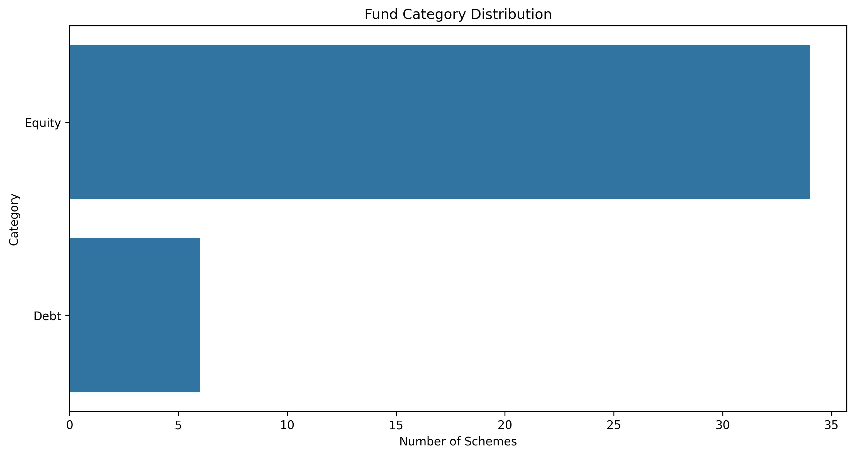
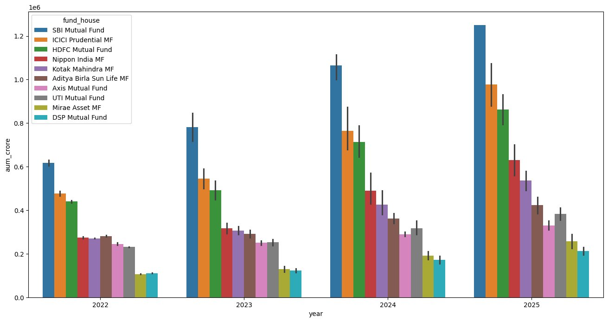
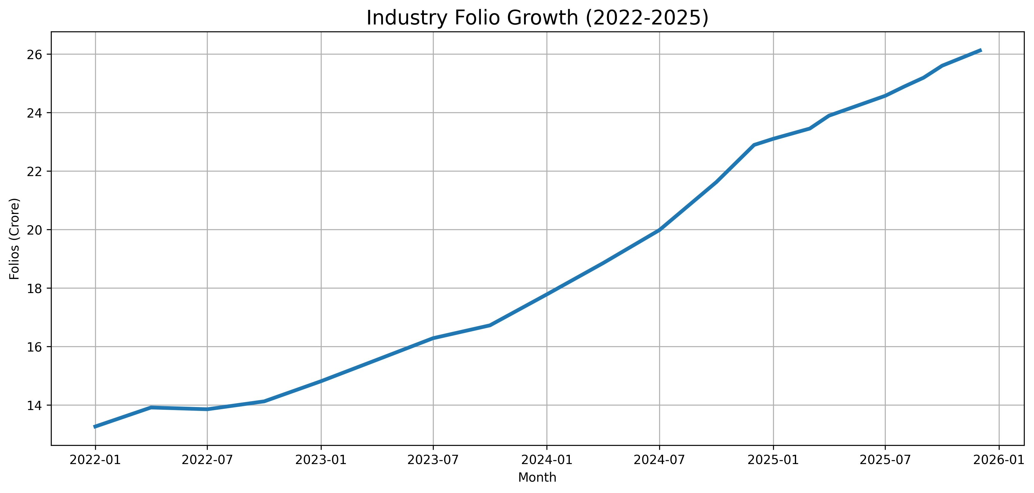
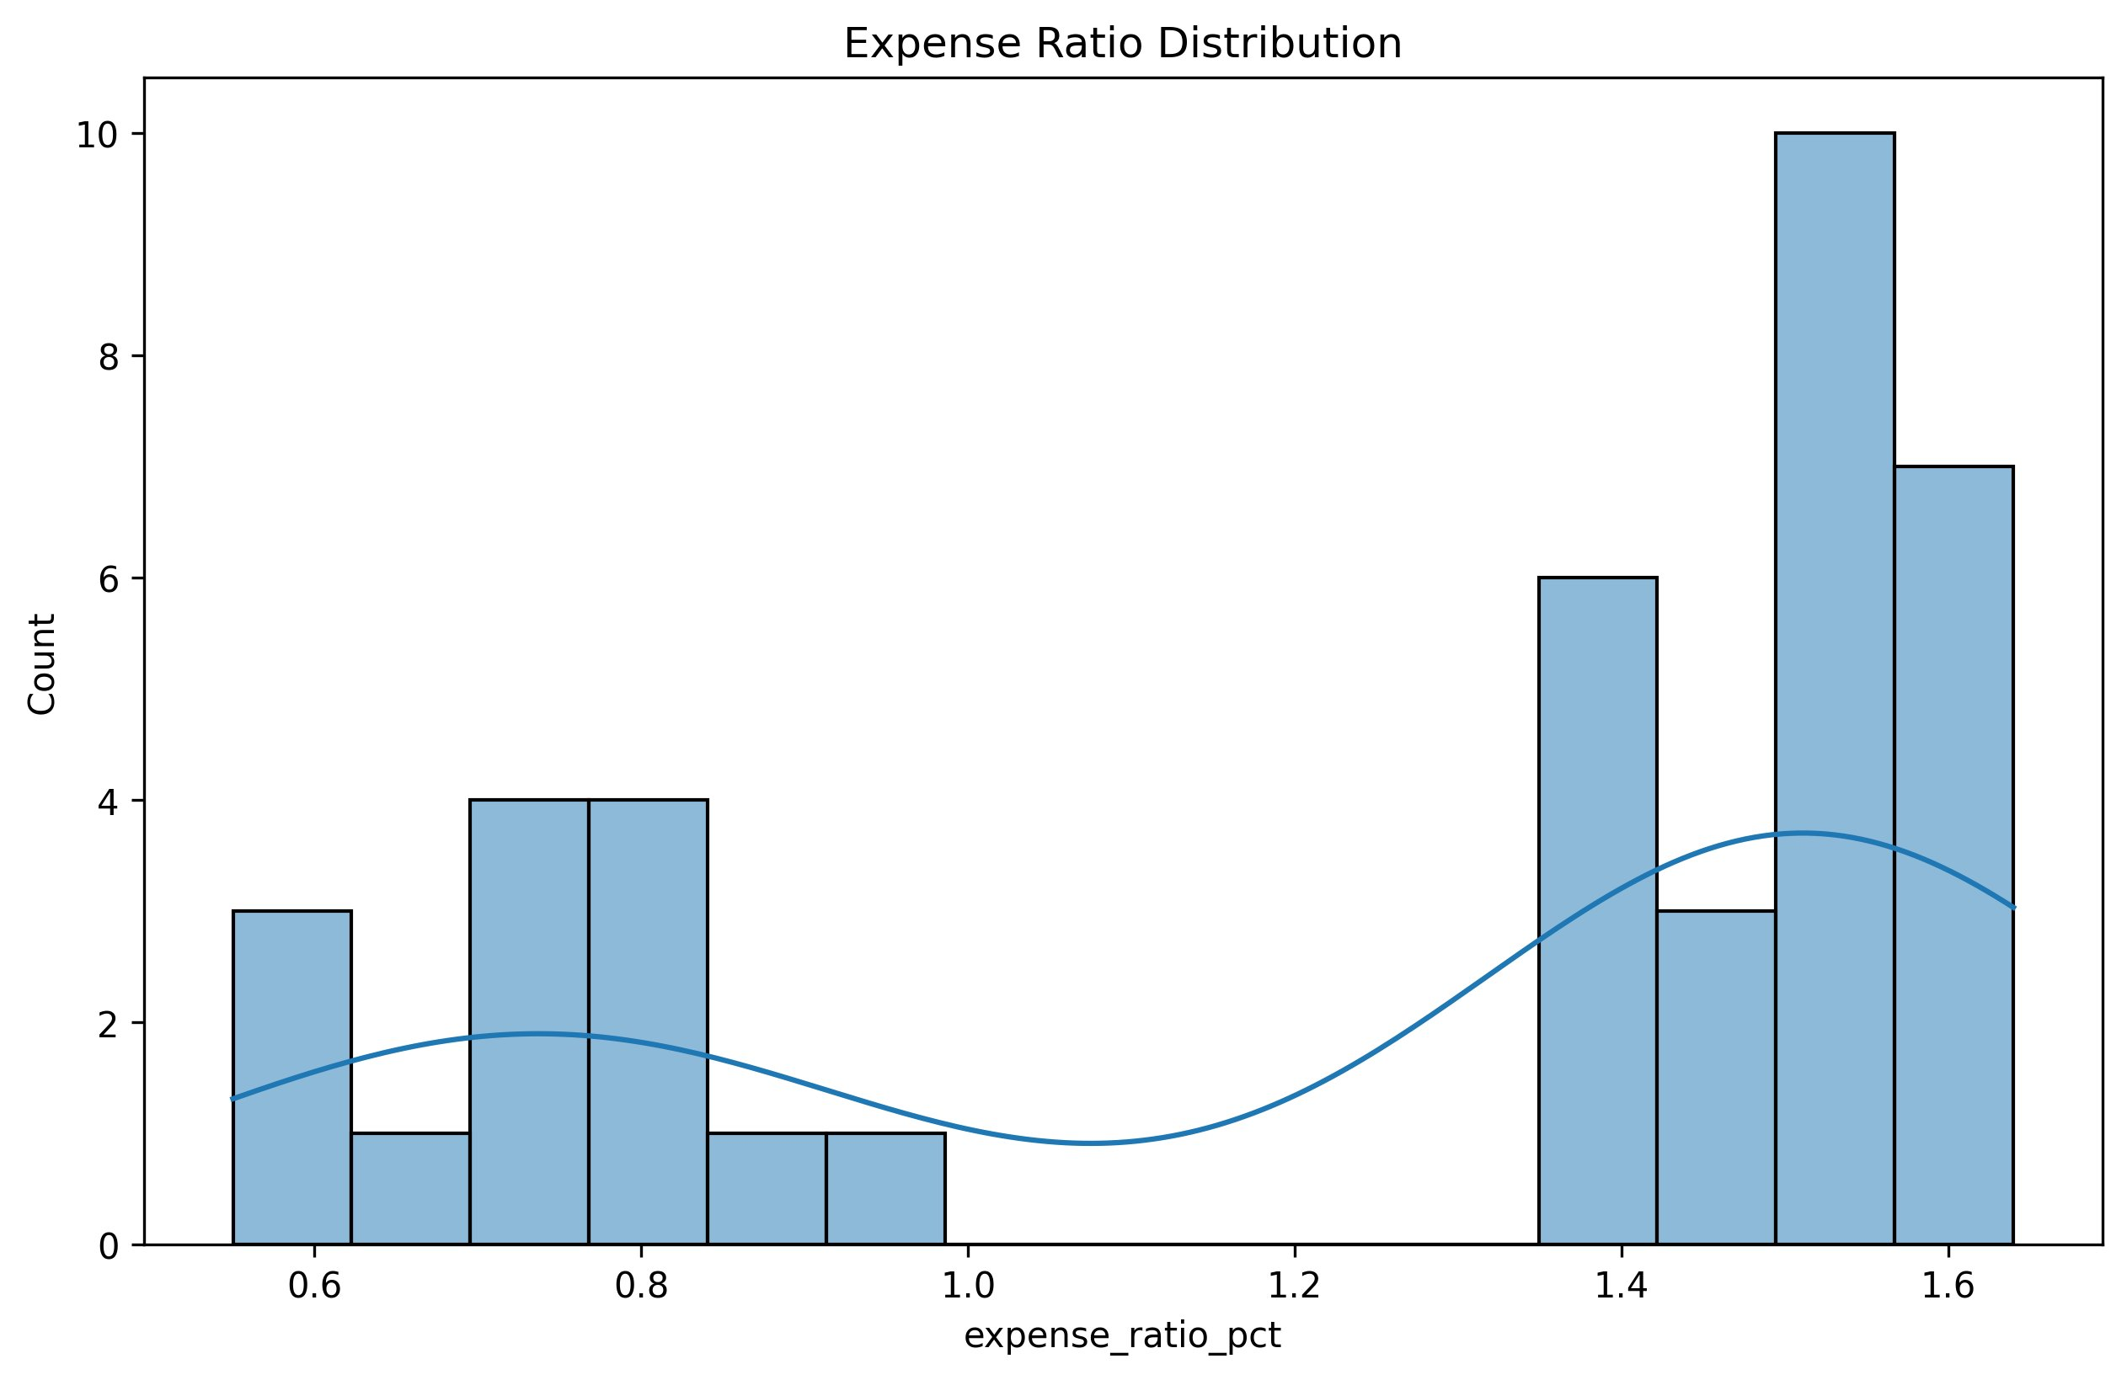
EDA Highlights (1/2) — Industry & Market Analysis
Figures 1–4: Generated by features.py + EDA notebooks from processed CSV files
Fund Category Split
AUM Growth Trends
34 Equity (85%) vs 6 Debt (15%) schemes
SBI leads at ₹1.25M Cr (2025) — nearly 2× growth
Fig 1: Fund Category Distribution
Fig 2: AUM Growth by Fund House (2022–2025)
Folio Count Growth
Expense Ratio Analysis
13.3 Cr → 26.0 Cr folios — 95.5% growth in 4 years
Bimodal: Direct 0.6–0.8% vs Regular 1.4–1.65%
Fig 3: Industry Folio Growth (2022–2026)
Fig 4: Expense Ratio Distribution
Bluestock Fintech | MutualFundAnalytics | Mutual Fund Analytics Capstone | June 2026
5 / 12

Slide 6
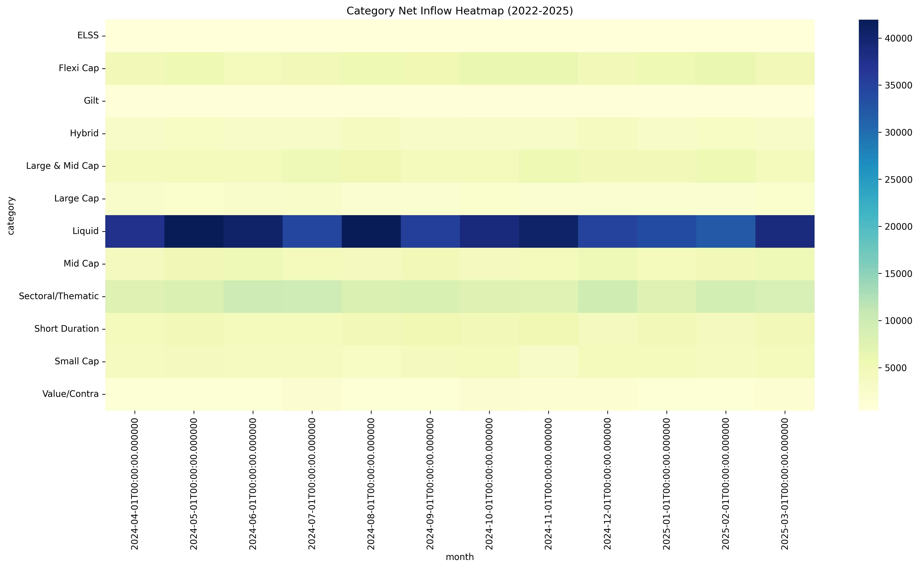
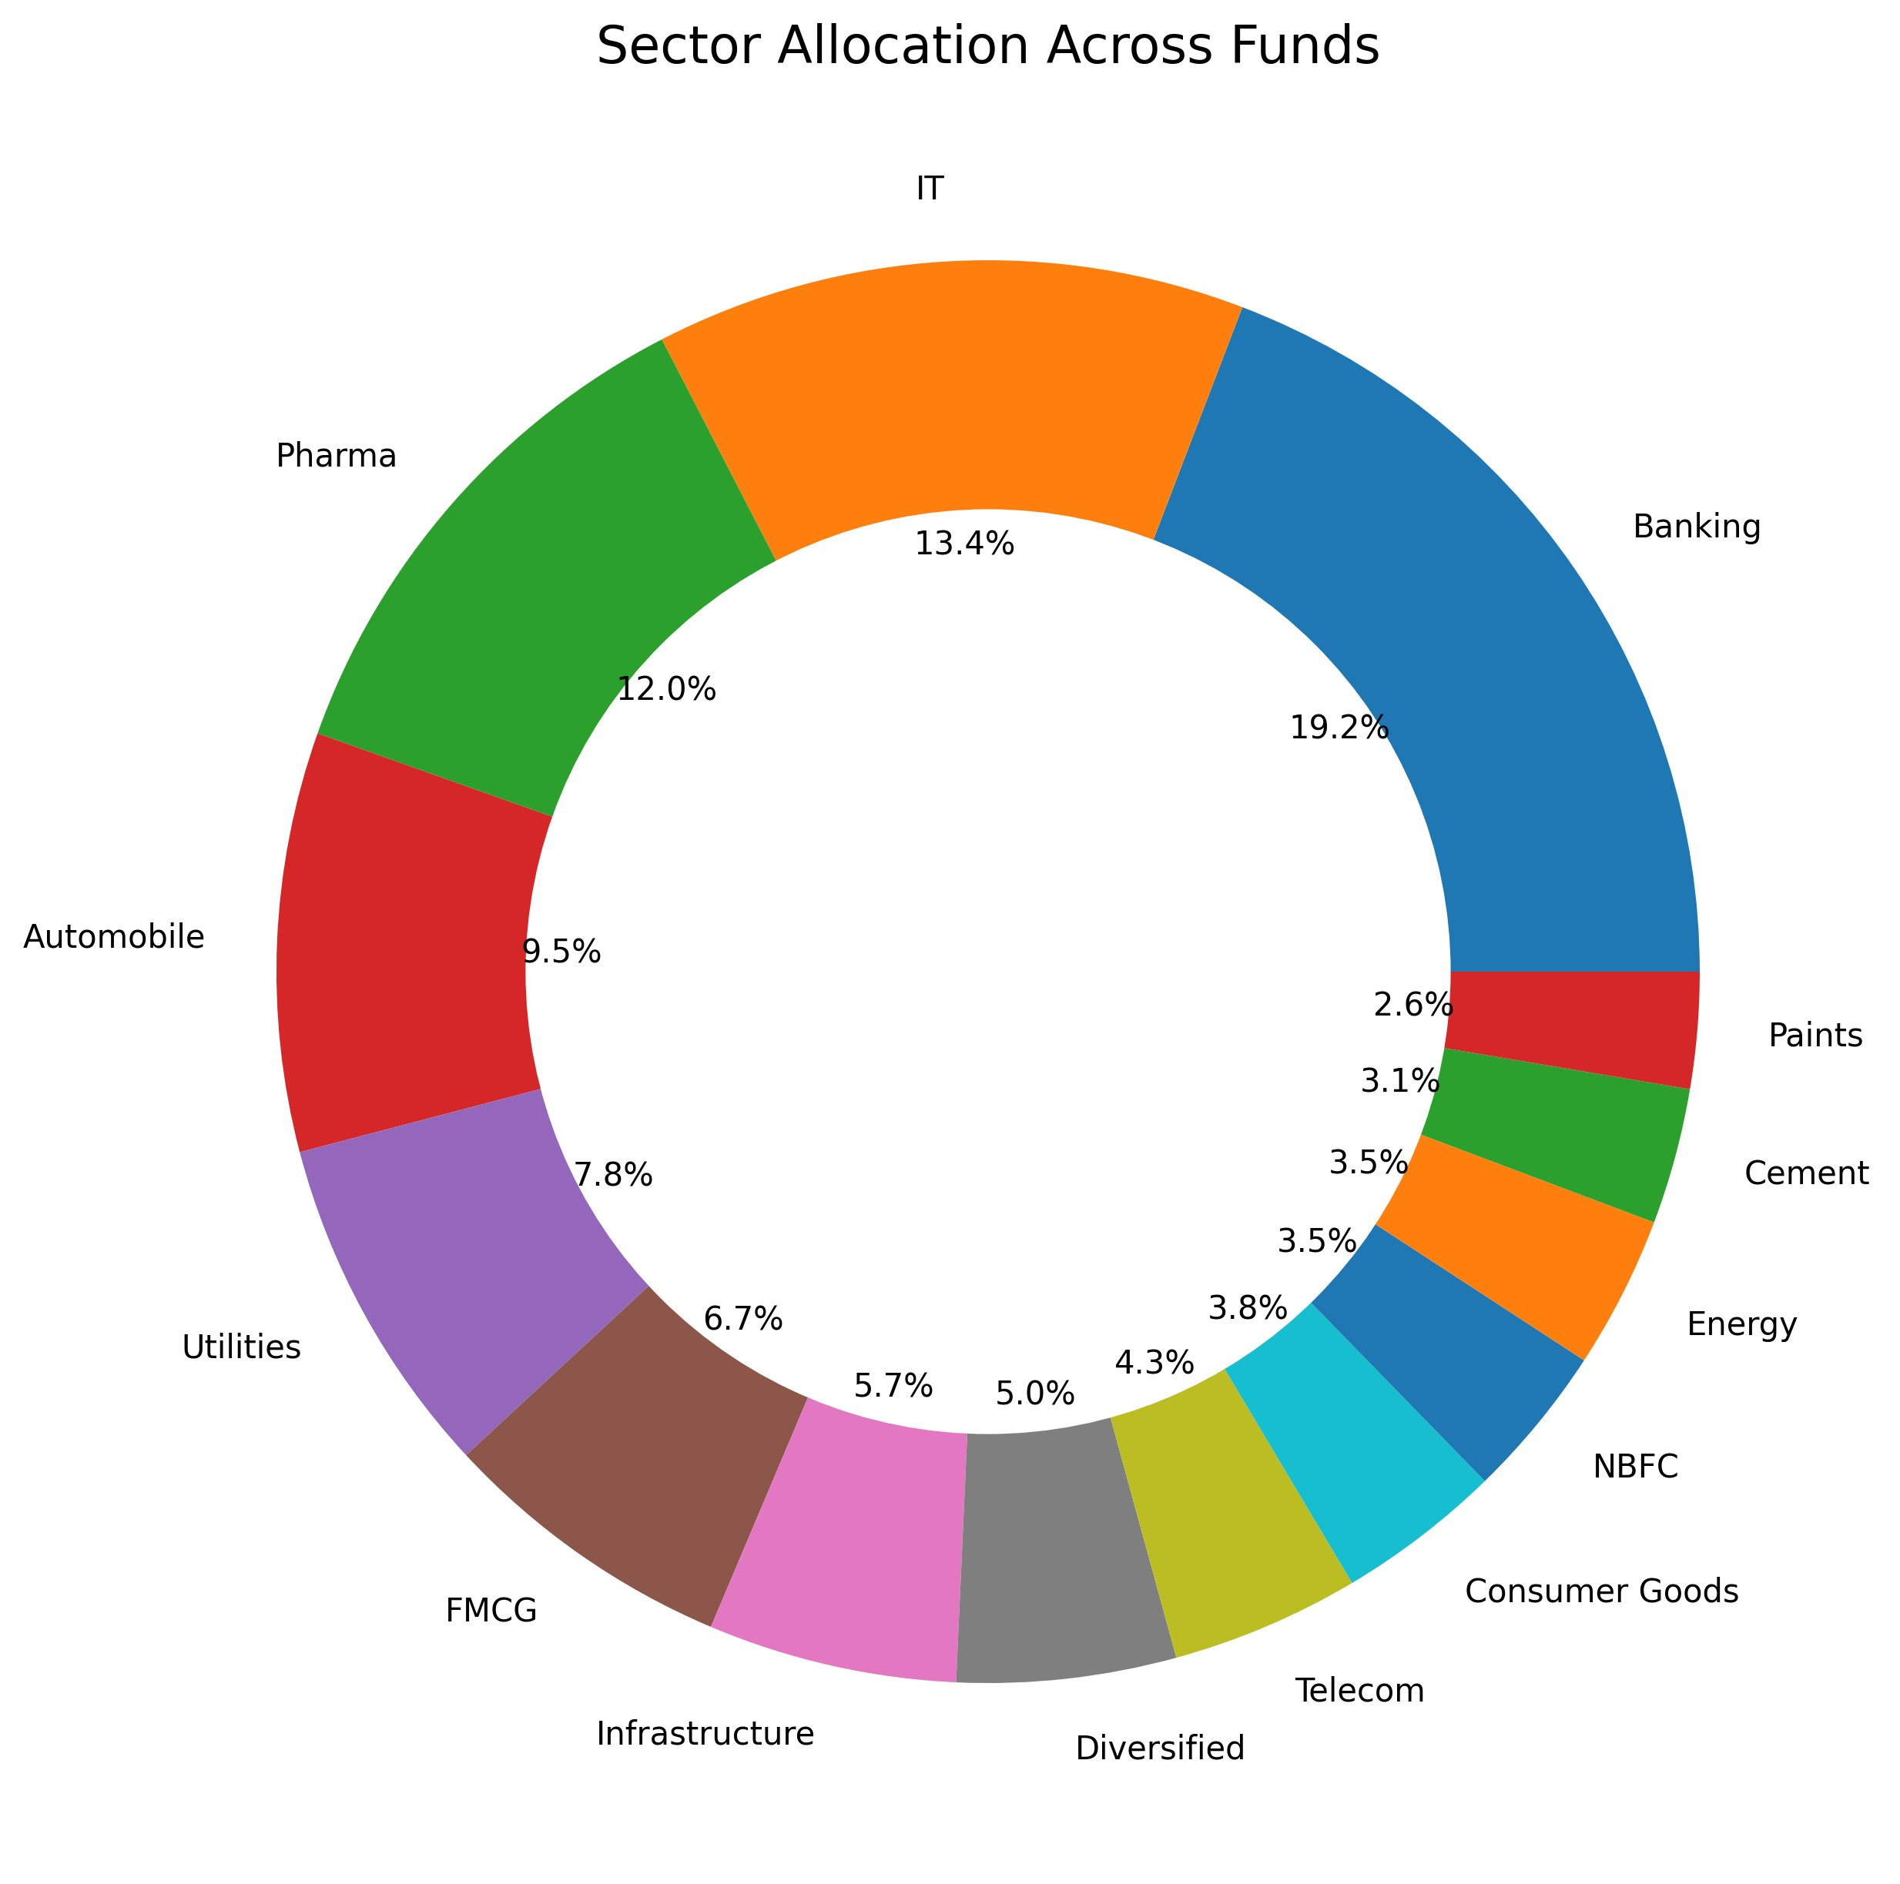
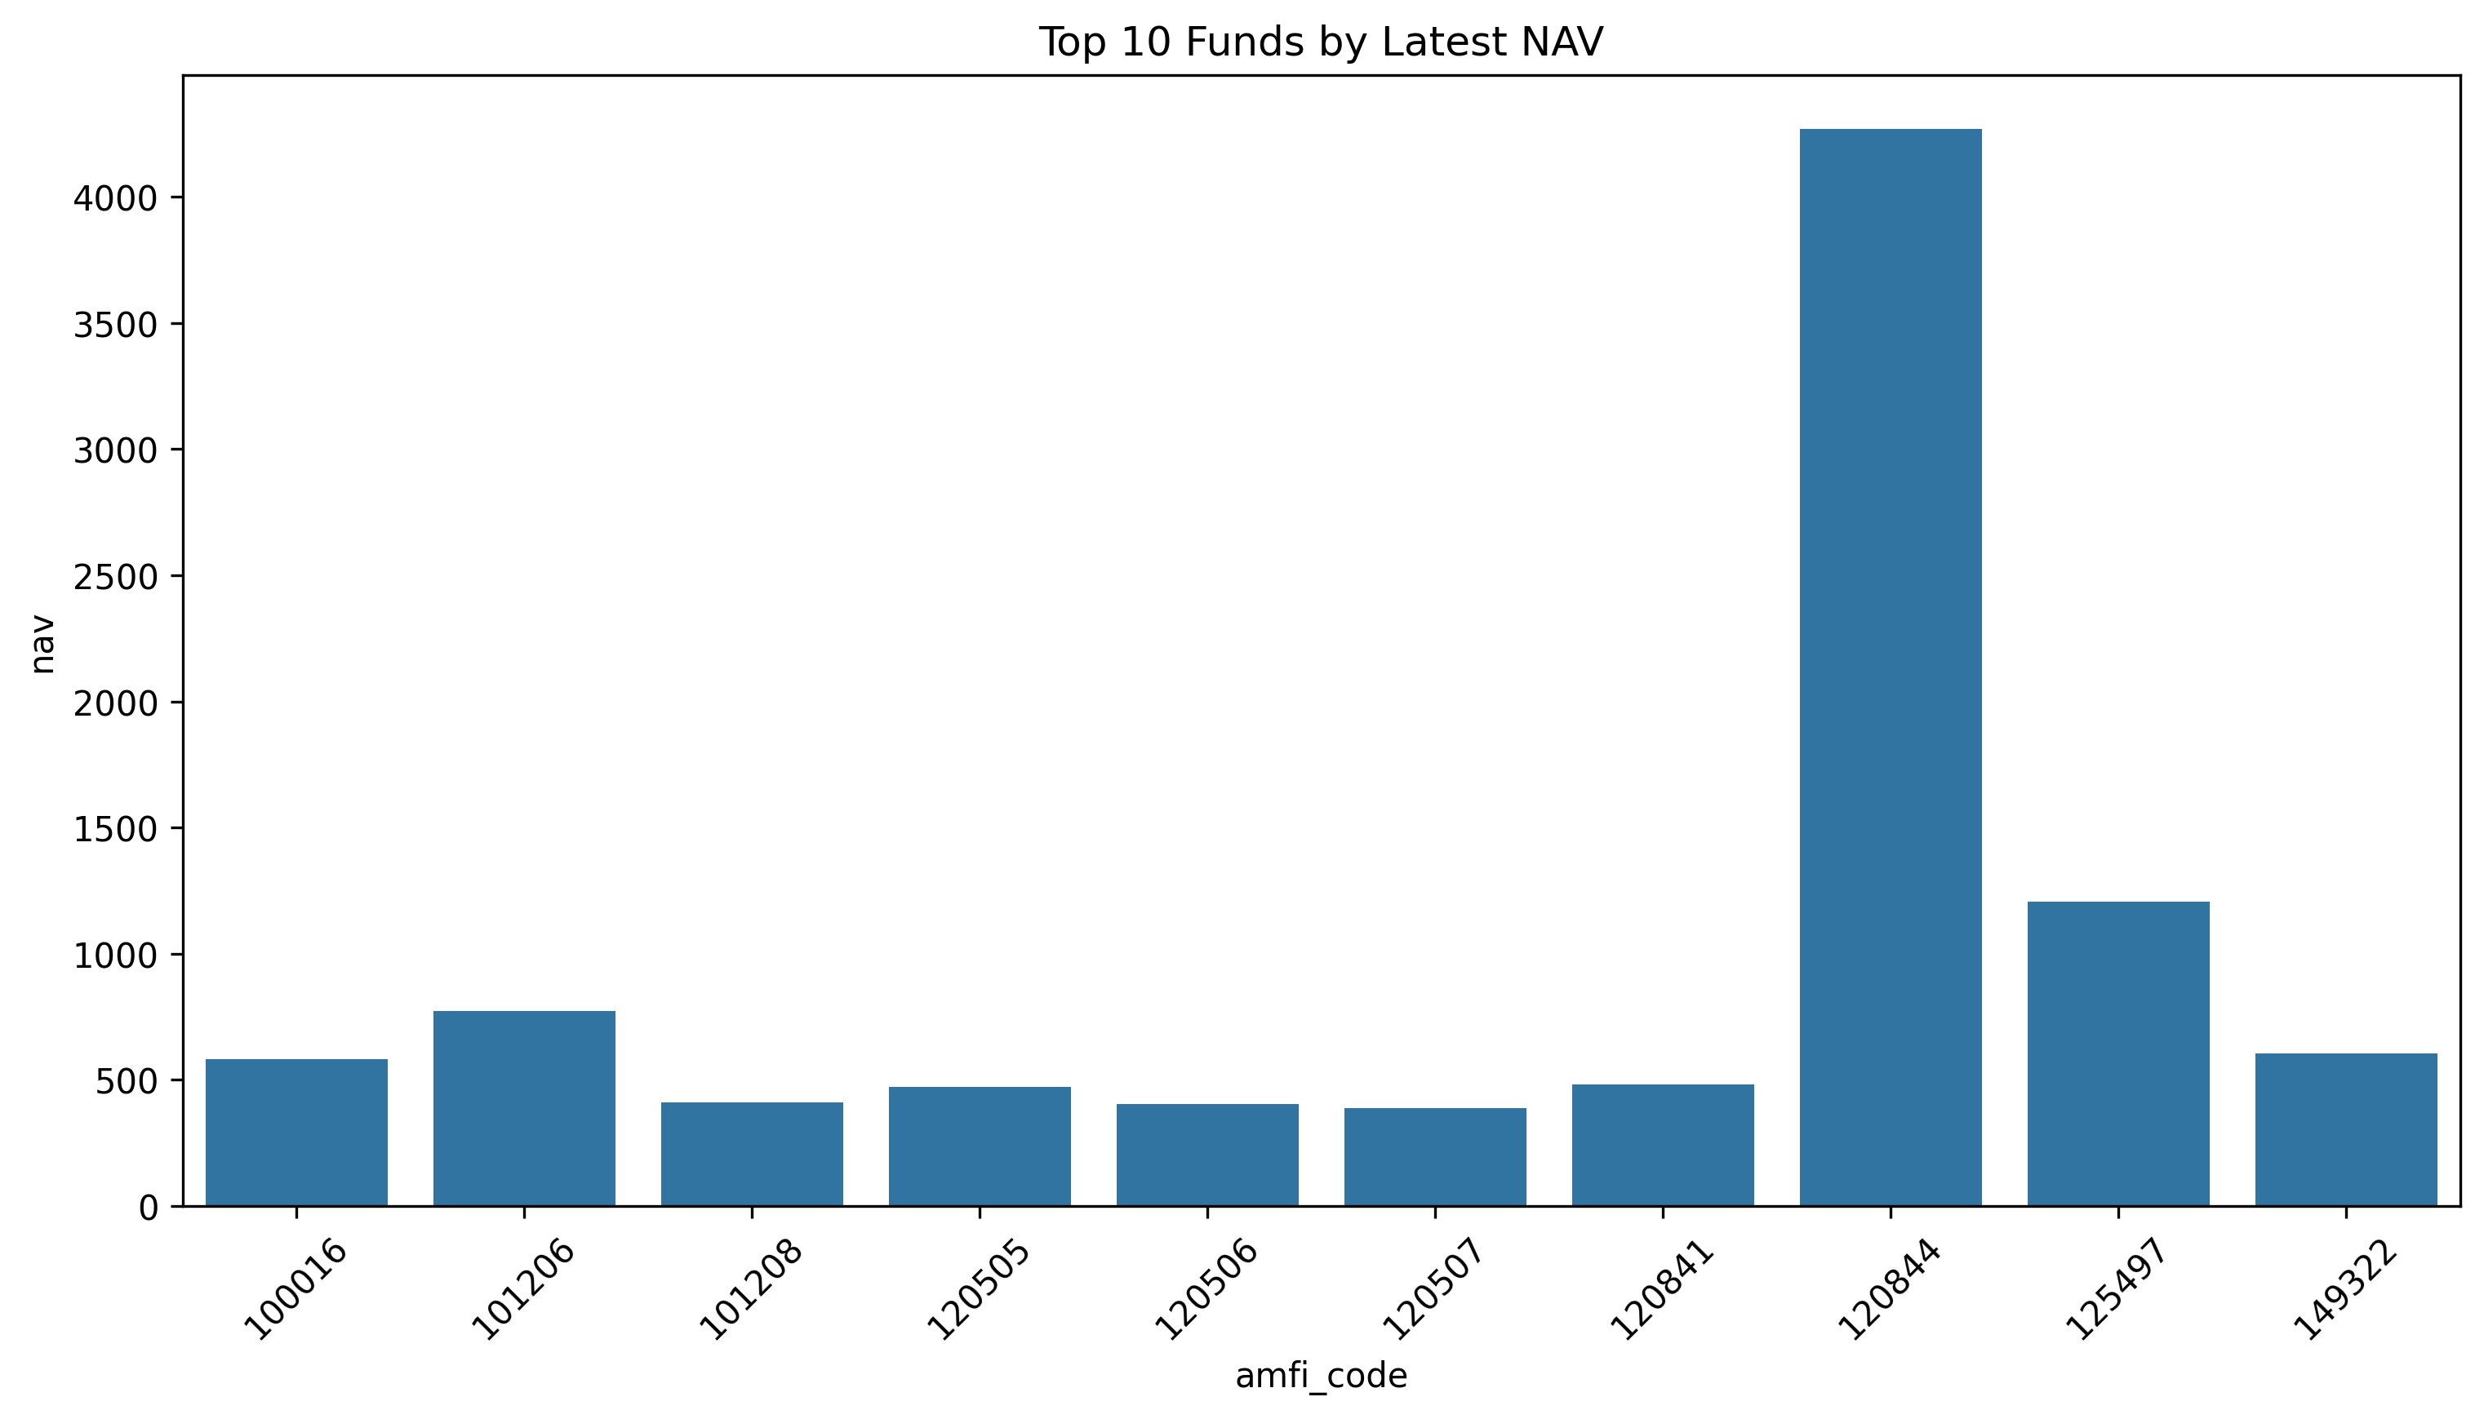
EDA Highlights (2/2) — Market Flow, Sector & NAV Analysis
Figures 5–7: Category inflow heatmap, sector allocation donut, and top NAV ranking
Category Net Inflow Heatmap (Apr 2024 – Mar 2025)
Sector Allocation Across All Funds
Fig 6: Banking 19.2%, IT 13.4%, Pharma 12.0% — top 3 = 44.6%
Fig 5: Liquid funds dominate — ₹20,000–40,000+ Cr net inflows monthly (2024–25)
Top 10 Funds by Latest NAV (₹)
Key Heatmap Insights
Liquid: ₹20,000–40,000+ Cr inflows every month — corporate treasury dominance
Sectoral/Thematic: Second-highest — driven by PSU + infrastructure fund launches
Equity categories (Mid Cap, ELSS, Flexi): Muted net inflows — high redemptions offset gross flows
Gilt & Hybrid: Near-zero — interest rate uncertainty suppressed duration appetite
Fig 7: AMFI 120844 leads at ₹4,250+ — 20+ years of compounding
Bluestock Fintech | MutualFundAnalytics | Mutual Fund Analytics Capstone | June 2026
6 / 12

Slide 7
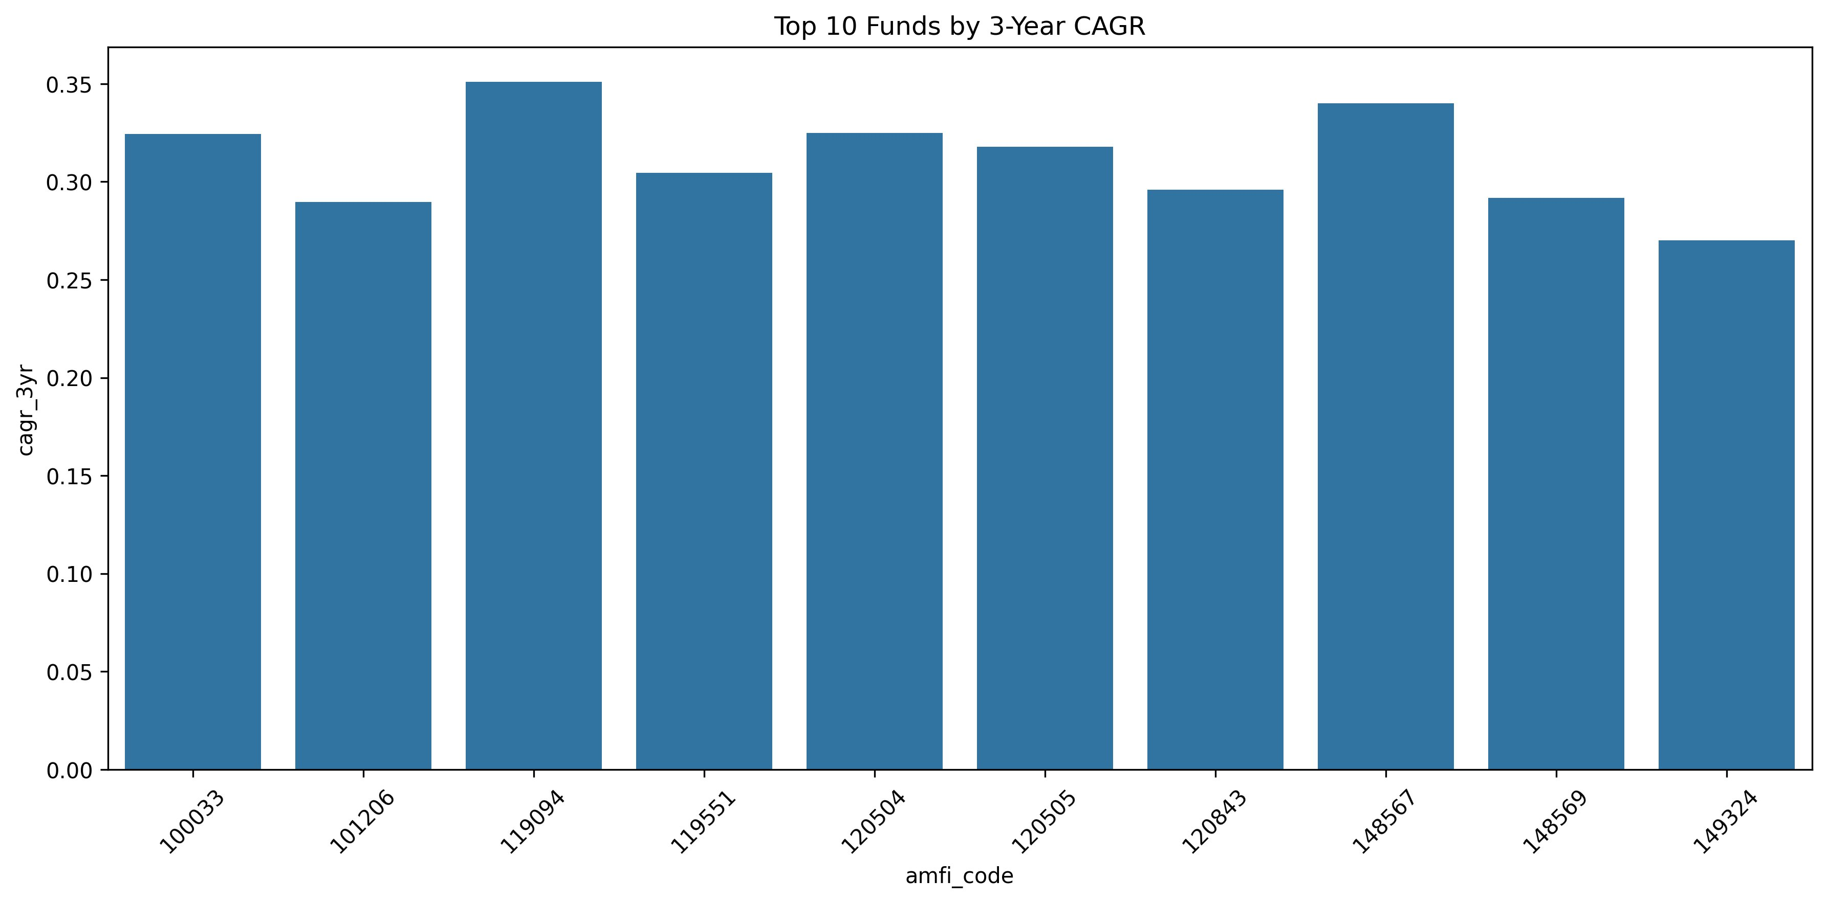
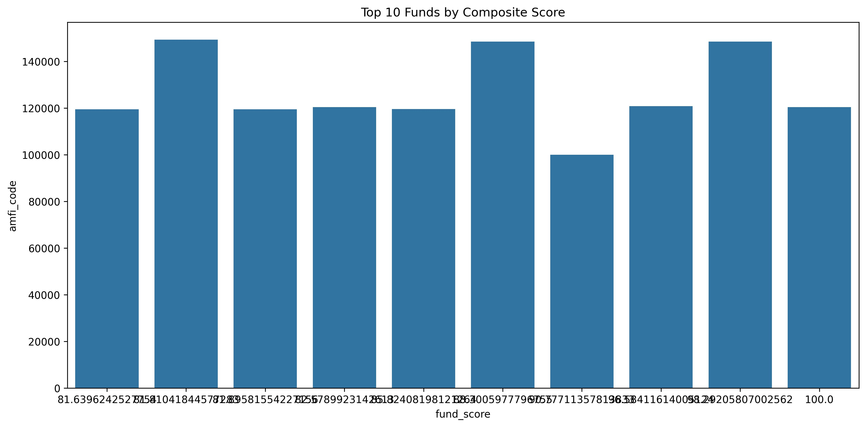
Performance Metrics (1/2) — CAGR, Fund Score & Composite Ranking
Data source: fund_scorecard.csv + cagr_comparison.csv | 40 funds analyzed
16.72%
0.54
15.91%
53.54
Avg CAGR (All 40 Funds)
Avg Sharpe Ratio
Avg Alpha vs Benchmark
Avg Fund Score (0–100)
Top 10 Funds by 3-Year CAGR
🏆 Top 5 by 3Y CAGR
#
AMFI
Fund Name
3Y CAGR
1
119094
Axis Midcap Fund – Regular
35.1%
2
148567
Mirae Asset Large Cap
34.0%
3
120504
DSP Midcap Fund – Direct
32.5%
4
100033
HDFC Mid-Cap Opp. Fund
32.4%
5
120505
ICICI Pru Midcap Fund
31.8%
Top 10 Funds by Composite Score (0–100)
Fig 8: All top 10 funds show 3Y CAGR > 27% — far above NIFTY 50 avg of 14–16%
Fig 9: Top 10 Fund Scores range 81.6 to 100.0 — tight quality cluster
⭐ ICICI Pru Midcap (120505): Fund Score 100.00 — top in ALL 5 scoring dimensions: CAGR, Sharpe, Alpha, Expense Efficiency & Drawdown Protection
Bluestock Fintech | MutualFundAnalytics | Mutual Fund Analytics Capstone | June 2026
7 / 12

Slide 8
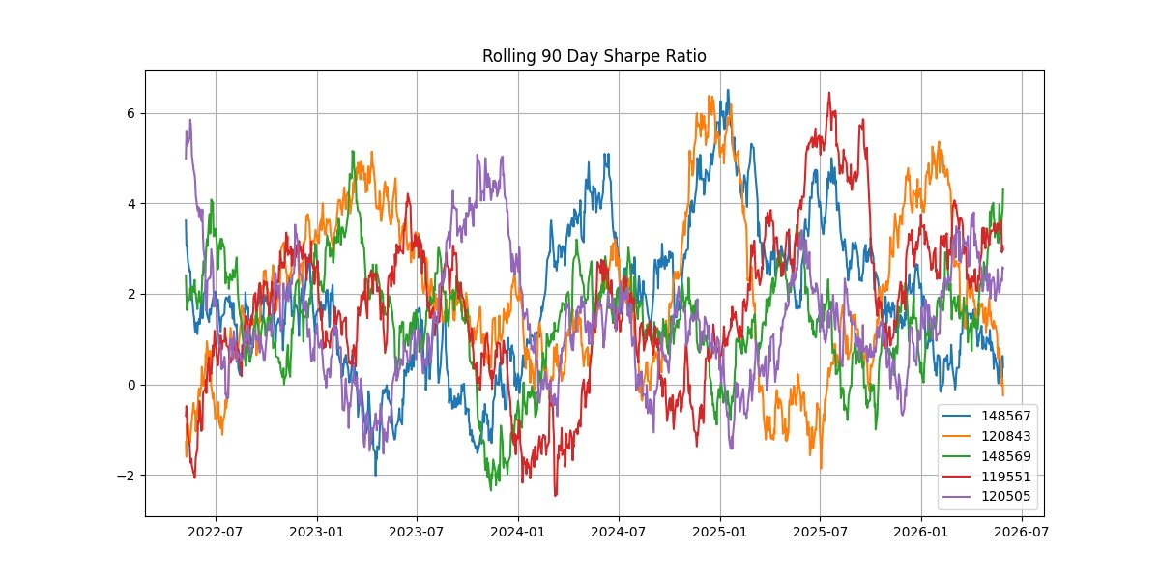
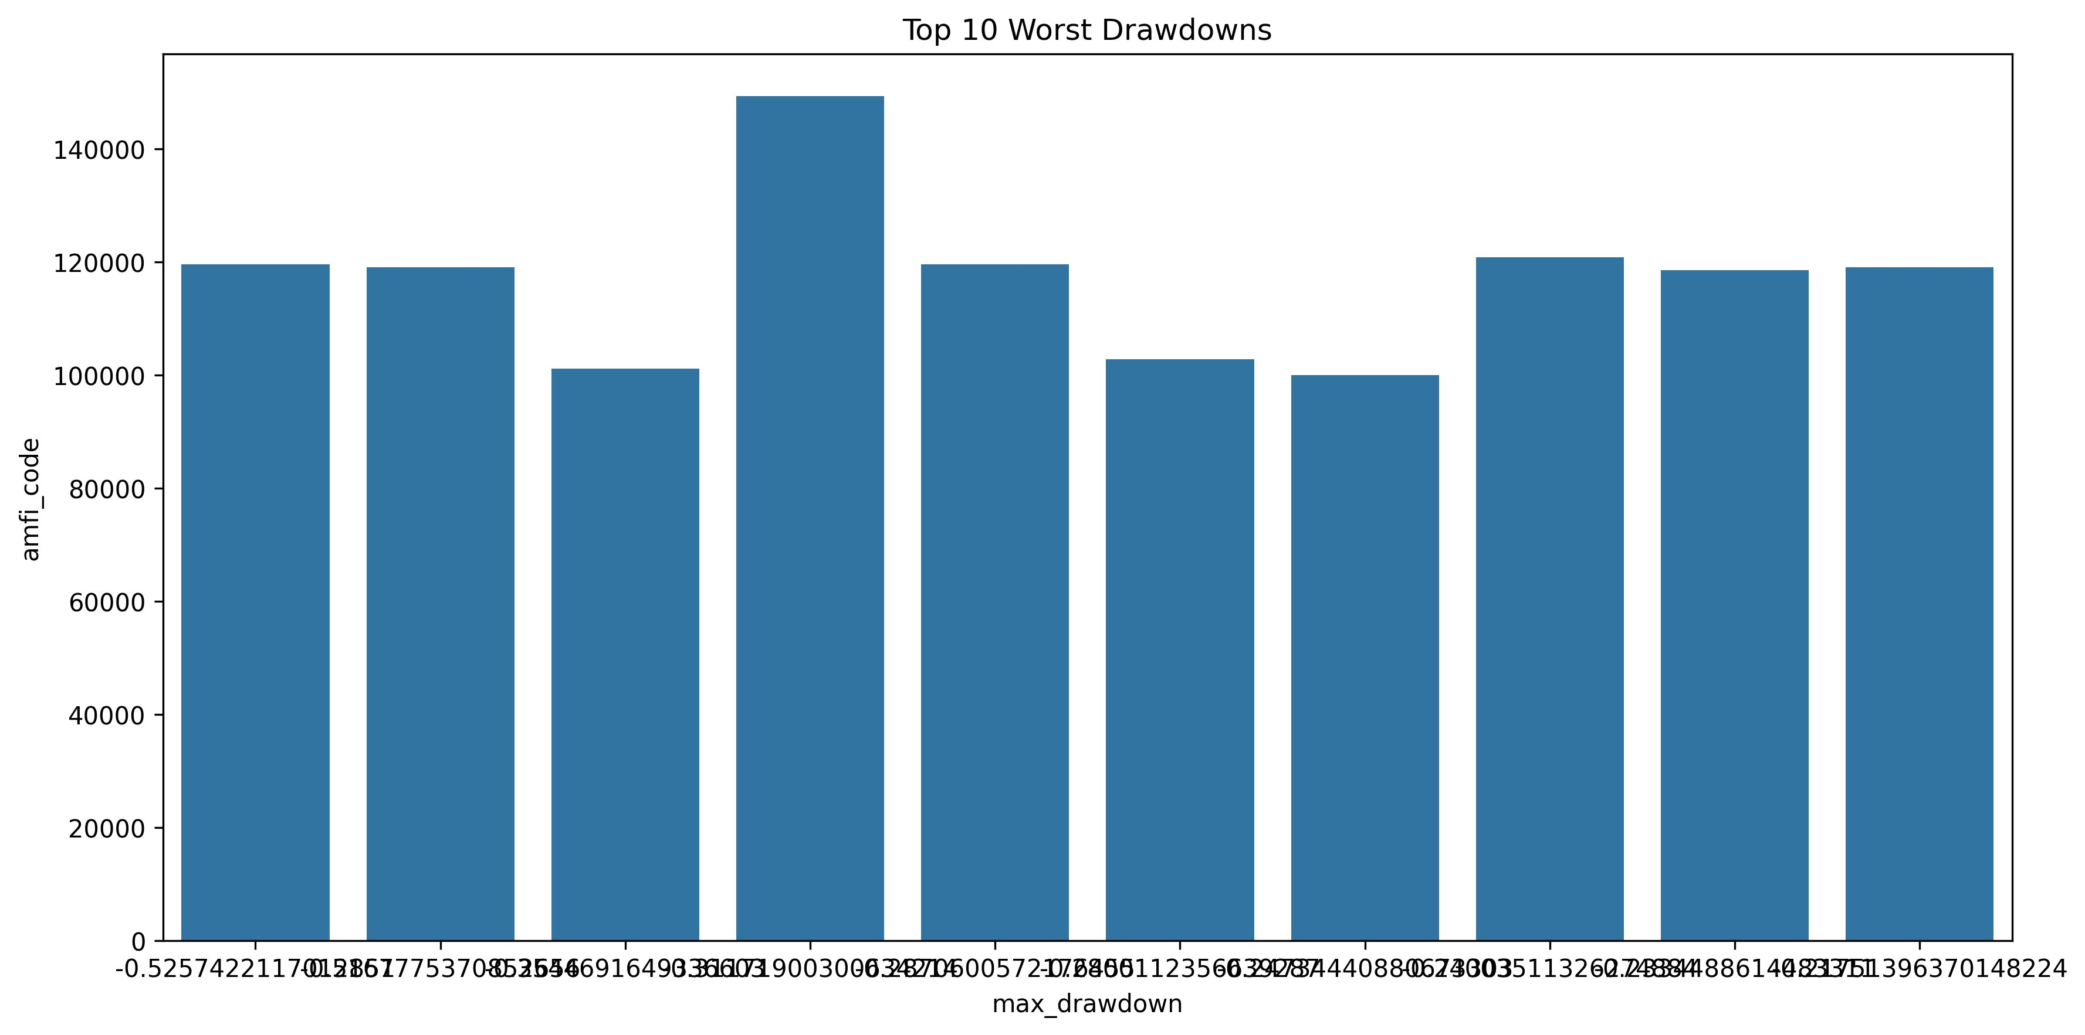
Performance Metrics (2/2) — Rolling Sharpe, Risk & Maximum Drawdown
Data source: var_cvar_report.csv + drawdown_periods.csv | Risk quantification for all 40 funds
−1.47%
−1.86%
−52.57%
2 Ongoing
Avg VaR (95%)
Avg CVaR (95%)
Worst Max Drawdown
Active Drawdowns (2026)
Rolling 90-Day Sharpe Ratio — Top 5 Funds (2022–2026)
Top 10 Worst Maximum Drawdowns
Fig 11: Top 10 worst drawdowns — all 5 worst are Small Cap funds
⚠️ Top 5 Worst Drawdowns — Source: drawdown_periods.csv
Fig 10: All 5 funds showed negative Sharpe in late-2023/early-2024 (FII selling + rate hike fears)
AMFI
Max DD
Period
Status
148567: Mirae Asset Large Cap
120843: Kotak Flexicap
148569: Mirae Tax Saver
119551: SBI Bluechip Direct
120505: ICICI Pru Midcap
119599
-52.57%
Jan 2023→Oct 2025
Resolved
119095
-51.68%
May 2025→May 2026
🔴 ACTIVE
101207
-35.45%
Nov 2024→May 2026
🔴 ACTIVE
149324
-31.17%
May 2024→Jan 2025
Resolved
119598
-28.70%
Aug 2024→May 2025
Resolved
Bluestock Fintech | MutualFundAnalytics | Mutual Fund Analytics Capstone | June 2026
8 / 12

Slide 9
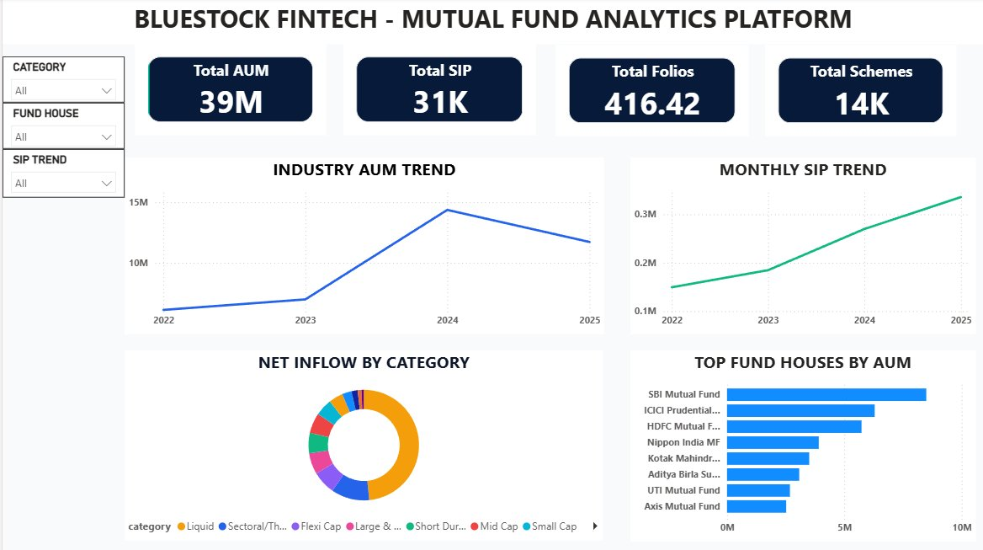
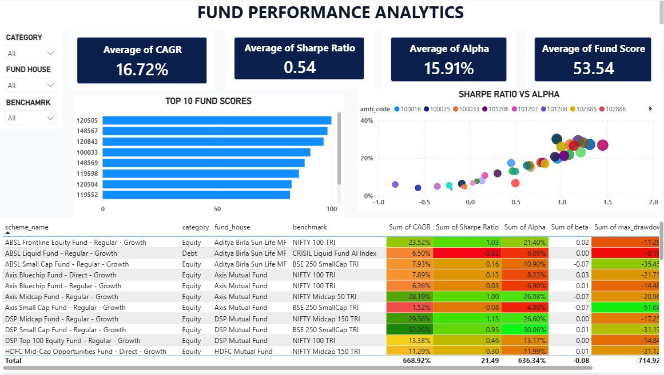
Power BI Dashboards (1/2) — Industry Overview & Fund Performance
File: bluestock_mf_dashboard.pbix | 4 interactive pages with live CSV connections and cross-filtering slicers
📊 Page 1 — Industry Overview Dashboard
📈 Page 2 — Fund Performance Analytics
₹39M
31K
416
14K
16.72%
0.54
15.91%
53.54
Total AUM
Total SIP
Folios
Schemes
Avg CAGR
Avg Sharpe
Avg Alpha
Avg Score
● SBI → ICICI → HDFC: Consistent top-3 AUM hierarchy 2022–2025
● Sharpe vs Alpha scatter: Strong positive correlation — active mgmt adds value
● SIP Trend: 3× growth from ₹0.1M (2022) to ₹0.3M+ (2025)
● Top 10 Scores: AMFI 120505, 148567, 120843, 100033, 148569 form elite cluster
Bluestock Fintech | MutualFundAnalytics | Mutual Fund Analytics Capstone | June 2026
9 / 12

Slide 10
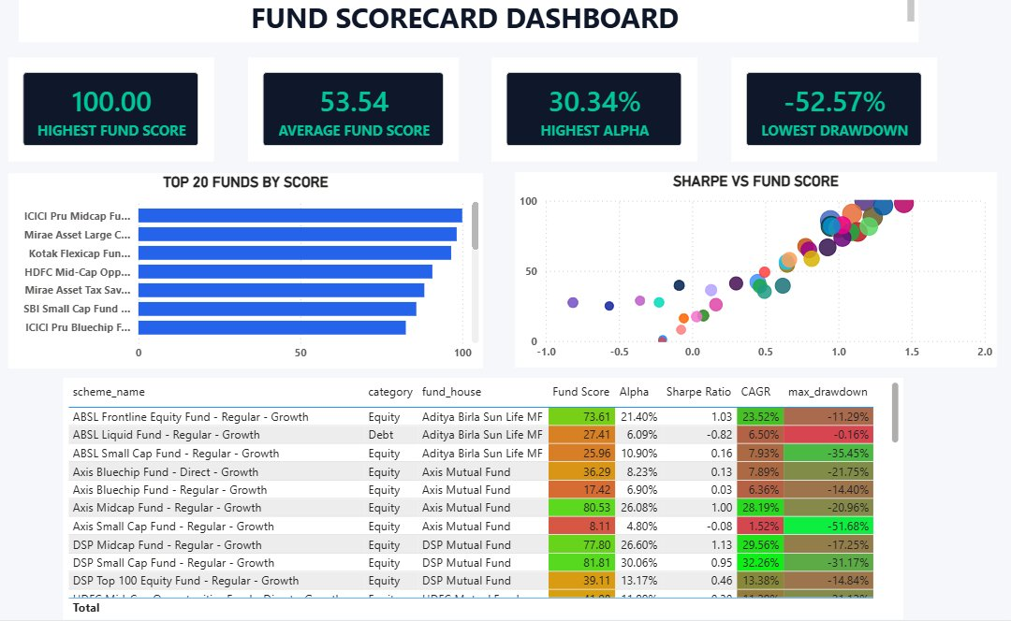
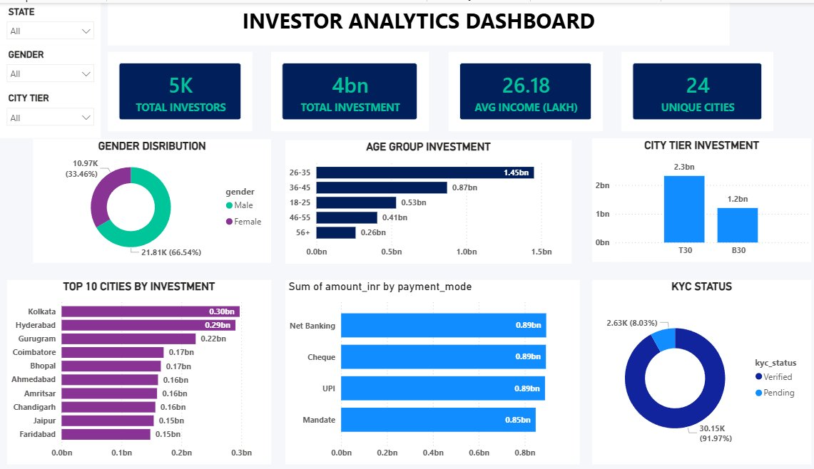
Power BI Dashboards (2/2) — Fund Scorecard & Investor Analytics
All 4 pages connect live to CSV files in MutualFundAnalytics/ — Filters cross-apply across all visuals
🏆 Page 3 — Fund Scorecard Dashboard
👥 Page 4 — Investor Analytics Dashboard
100.00
53.54
30.34%
-52.57%
5K
₹4bn
₹26.18L
24
Highest Score
Avg Score
Highest Alpha
Worst Drawdown
Investors
Investment
Avg Income
Unique Cities
● Top 20 funds: ICICI Pru Midcap → Mirae Asset Large Cap → Kotak Flexicap
● 26–35 age group: 41.1% of investors — millennial-first platform confirmed
● Sharpe vs Score bubble: Confirms scoring model — high score = high Sharpe
● KYC: 91.97% verified | Payment modes split equally at ~₹0.87bn each
Bluestock Fintech | MutualFundAnalytics | Mutual Fund Analytics Capstone | June 2026
10 / 12

Slide 11
Key Findings & Insights
6 data-driven findings derived directly from MutualFundAnalytics project outputs
F1
Mid-Cap is India's Performance Sweet Spot
F2
Folio Growth is Accelerating
F3
Expense Ratio: The Hidden Return Killer
3 of top 5 composite-scored funds are Mid-Cap. They combine India's corporate growth story with better liquidity than small-caps. Top 3Y CAGR: Axis Midcap at 35.1%
13.3 Cr (Jan 2022) → 26.0 Cr (Jan 2026). Sharpest growth rate in 2024–2026 period. Structural bull market in retail adoption. CMGR: 1.4%/month = 18% annual addition
Bimodal distribution: 40% at 0.6–0.8% (direct plans), 60% at 1.4–1.65% (regular). 0.85% annual gap compounds to 17%+ extra corpus over 20 years at 20% CAGR.
▶ Score > 80: ICICI Midcap, HDFC MidCap, Axis Midcap
▶ Folios nearly doubled in 4 years
▶ Direct plan saves 0.85% annually
▶ Best 3Y CAGR: 35.1% (Axis Midcap, AMFI 119094)
▶ Coincides with BSE Sensex crossing 70,000
▶ Over 20 years: 17%+ more final corpus
F4
Small-Cap Tail Risk Is Active & Unresolved
F5
Punjab & Tamil Nadu Are Emerging MF Hubs
F6
1,362 SIP Investors At Risk (27.2%)
All 5 worst drawdowns are small-cap funds. 2 drawdowns (Axis -51.7%, ABSL -35.5%) have trough dates of May–June 2026 — still ONGOING at time of analysis.
Both lead investor count (~3,000 each) and SIP volume (~₹32 Cr each). Maharashtra NOT in top 10 — confirms successful B30 city penetration strategy.
AT_RISK classification: avg payment gap of 64.9 days across 1,362 investors. Tiered intervention: CRITICAL→HIGH→ MEDIUM based on gap duration.
▶ Worst drawdown: -52.57% (AMFI 119599)
▶ Punjab #1 by both investors AND SIP volume
▶ 2024 Cohort AUM: ₹3,491 Crore (99.1%)
▶ 4.7× more risk vs Mirae Large Cap (-11.3%)
▶ 12 states contribute ₹35–38 Cr/month SIP
▶ 2025 Cohort: Higher avg SIP = ₹1,09,158
Bluestock Fintech | MutualFundAnalytics | Mutual Fund Analytics Capstone | June 2026
11 / 12

Slide 12
Thank You
Bluestock Fintech | Mutual Fund Analytics Capstone | MutualFundAnalytics
Workspace: MutualFundAnalytics.code-workspace | GitHub: v1.0 tag
40 Funds
15 Charts
4 Pages
8 CSVs
Schemes Analyzed
Original EDA
Power BI Dashboard
Output Datasets
100.00
35.1%
1,362
v1.0
Highest Fund Score (ICICI Pru Midcap)
Best 3Y CAGR (Axis Midcap)
SIP At-Risk Investors
GitHub Release Tag
📁 GitHub: Karthikeya1184/MutualFundAnalytics | Branch: main | Tag: v1.0
📊 Dashboard: bluestock_mf_dashboard.pbix |
Data Sources: AMFI India (amfiindia.com) • mfapi.in • NSE India • BSE India • SEBI Portal
Tools: Python 3.10 • Pandas • NumPy • Matplotlib • Seaborn • Power BI • SQLite • ReportLab • python-pptx • Git
Bluestock Fintech | MutualFundAnalytics | June 2026 | 12 / 12

